Slide 1
Innovation Geeks
IIM Calcutta
Girish Dev Kumar
Ola money

Slide 2
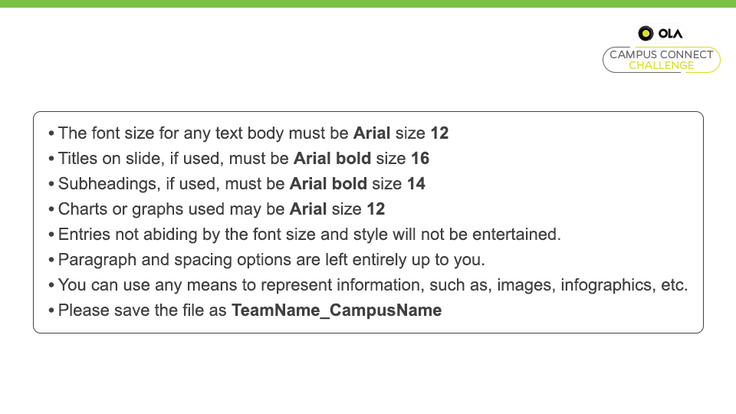

Slide 3
Future of credit cards in India
demand
Culture: Credit (udhaar) is looked down upon which prevents consumers form purchasing credit cards
Lack of awareness: Credit cards and their benefits are not widely publicized
High penal interest: penal interest is as high as 49% which instills apprehension over the huge penalty they might have to pay
Increased expenditure: the life style is affected and people tend to spend more then their income which results In reluctance
Fraud apprehension: non- existence of laws for liability of companies and institutes in case of security breaches
Credit card issuers not providing lucrative offers: Lack of targeted lucrative offers
supply:
CIBIL score : only 10% of the total population is eligible for the credit cards as per the CIBIL score
No proper consumer segmentation:
Lack of supply channels in Rural areas
S
Positioning
Rural: collaborate with government in providing incentives, resolving lack of internet, helping rural business to start accepting credit cards, providing more banking locations in rural areas.
Housewives: special offers on grocery shopping and gender specific offers such as parlour, apparel shopping.
Financial education: In conjunction with Indian government, Ola credit card shall come up with campaigns in order to instill confidence in people
Low income groups: lower income groups can be provided with credit cards with lower limits and suitable offerings based on their spending trends.
Older age: chatbot assistance and can have a dedicated card for this segment with rebate on penal interest rate.
Students: UG/PG students shall be offered cards with limits as per their family income
Segmentation
RURAL VS URBAN
GENDER
AGE GROUPS
INCOME GROUPS
GROUPS BASED ON FINANCIAL EDUCATION LEVEL
Targeting
Rural - Our geographic indicator of living in a rural area proxies for a barrier on the supply side
Housewives – they tend to financially depend on the family irrespective of their requirements.
People with limited financial education- low financial education tend to make people apprehensive about credit card usage
Low income groups : at present targeted offerings to low income groups are close to non-existent
Older age: at older Age, people tend to have savings and are generally settled
Students: a high potential untapped segment, that requires some easy payment options for

